Slide 1
Statistical Foundations and Modern Methods in Machine Learning
Prof. Dr. Tanvir Ahmad

Slide 2
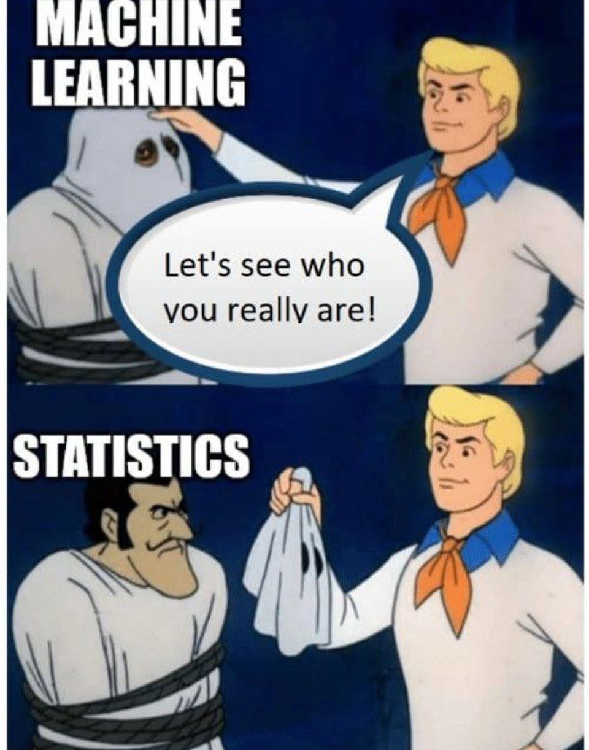

Slide 3
Abstract
Machine Learning is deeply rooted in statistical inference.
This talk explores how classical statistics underpin modern ML methods.
We discuss estimation, hypothesis testing, probabilistic modeling, and interpretability.
Real-world examples show the synergy between statistics and computational learning.

Slide 4
Key Themes Overview
1. Statistical Roots of Machine Learning
2. Probabilistic Modeling and Inference
3. Multivariate and High-Dimensional Challenges
4. Modern Learning Paradigms
5. Interpretability and Fairness
6. Toward a Unified Framework

Slide 5
Statistical Roots of Machine Learning
From regression and discriminant analysis to supervised learning.
Bias–variance tradeoff and overfitting: statistical interpretation.
The role of statistical inference in generalization.

Slide 6
Probabilistic Modeling and Inference
Likelihood, Bayesian inference, and uncertainty quantification.
Latent variables and the EM (Expectation-Maximization) algorithm.
Probabilistic thinking in model evaluation.

Slide 7
Multivariate and High-Dimensional Challenges
Curse of dimensionality and regularization (Lasso, Ridge).
Dimensionality reduction: PCA, manifold learning, and autoencoders.
Handling correlated features and multicollinearity.

Slide 8
Modern Learning Paradigms
Ensemble methods: Bagging, Boosting, Random Forests.
Deep learning architectures: statistical interpretation.
Probabilistic graphical models and Gaussian processes.

Slide 9
Interpretability and Fairness
Statistical interpretability vs algorithmic opacity.
Confidence intervals and model calibration.
Explainable AI (XAI) and responsible learning.

Slide 10
Toward a Unified Framework
Bridging theory with scalable computation.
Integrating probabilistic reasoning in ML pipelines.
The future of statistically principled machine intelligence.

Slide 11
Closing Remarks
Statistics and Machine Learning are not separate disciplines — they are complementary.
Statistical thinking enhances interpretability, robustness, and trust in AI.
Thank you for your attention!

Slide 12
Practical Demonstrations and Real-World Case Studies
• Healthcare Analytics: Predicting disease outcomes
using regression and random forests.
• Business Forecasting: Sales prediction using ensemble
learning and PCA.
• Environmental Data Modeling: Air quality prediction
from multivariate sensor data.
• The visual below illustrates a real-world data analysis
workflow.

Slide 13
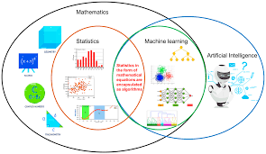

Slide 14
Visual appreciation
Here are visuals that illustrate how statistics and machine learning complement each other in data science and modeling. They highlight the synergy between theoretical rigor and predictive power.
The following images show how statistics and machine learning intersect and support each other:

Slide 15
Visual appreciation
Conceptual Venn Diagram
Shows overlapping areas: inference, prediction, data modeling, and uncertainty quantification.
Highlights how statistics focuses on understanding relationships and uncertainty, while machine learning emphasizes prediction and scalability.

Slide 16
Visual appreciation
Workflow Comparison
Depicts a side-by-side pipeline:
Statistics: hypothesis → model → inference → validation.
Machine Learning: data → features → model training → prediction.
Shows how statistical thinking improves feature selection, model interpretability, and validation.

Slide 17
Visual appreciation
Synergy in Practice
Combines statistical tools (e.g., regression, hypothesis testing) with machine learning algorithms (e.g., decision trees, neural networks).
Emphasizes hybrid approaches like Bayesian machine learning, regularized regression, and ensemble methods.

Slide 18
Visual appreciation
Medical Data Analysis Integration
Visualizes how statistical models (e.g., survival analysis) and machine learning (e.g., random forests) are used together in healthcare analytics.
Demonstrates complementary strengths: interpretability vs. accuracy.

Slide 19
Visual appreciation
Differences and Synergies between Statistics and Machine Learning
Common Statistical Concepts in Supervised Machine Learning
The Role of Statistics in Machine Learning and AI
Statistics vs Machine Learning in One Picture

Slide 20
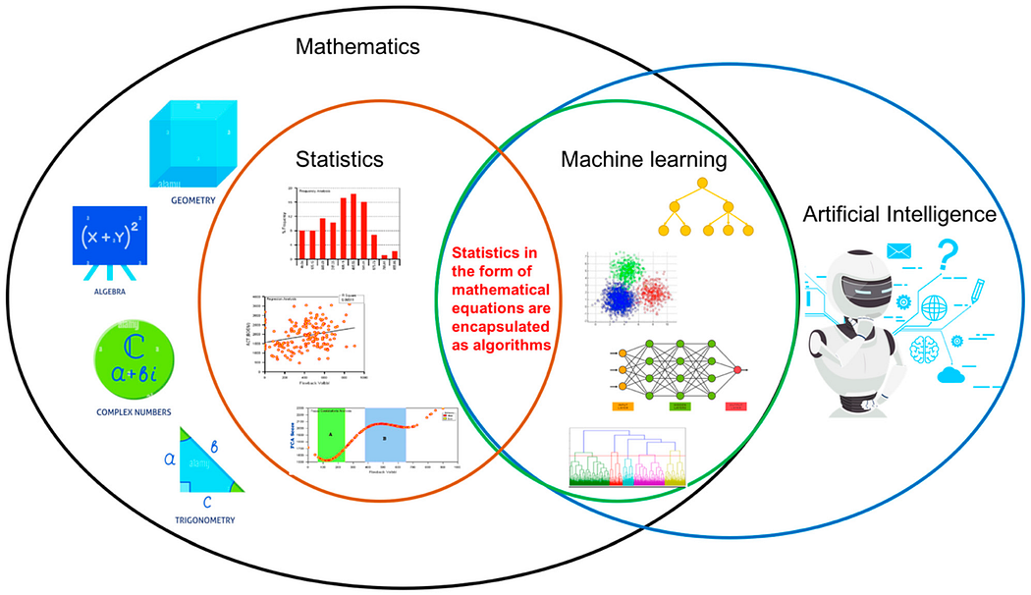
1

Slide 21
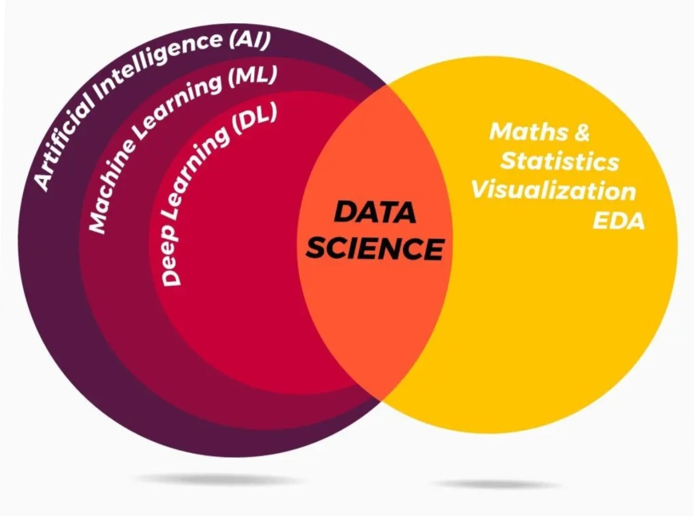
1

Slide 22
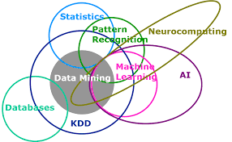
1

Slide 23
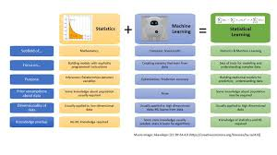
1

Slide 24
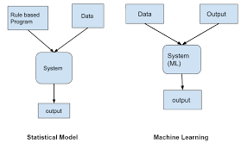
1

Slide 25
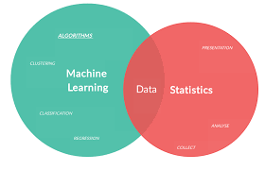
1

Slide 26
Audience and Duration
Intended Audience: Researchers, Data Scientists, Statisticians.
Duration: 30–40 minutes talk + 10 minutes Q&A.
Includes demonstrations and real-world case studies.

Slide 27
Visual appreciation

Slide 28
Audience and Duration
Intended Audience: Researchers, Data Scientists, Statisticians.
Duration: 30–40 minutes talk + 10 minutes Q&A.
Includes demonstrations and real-world case studies.

